Slide 1
Software Engineering and Architecture
REpresentational State Transfer

Slide 2
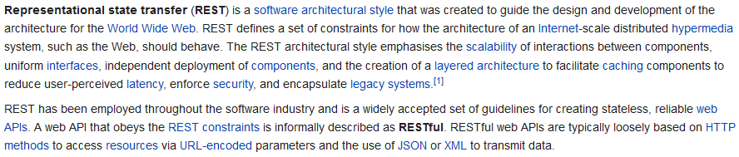
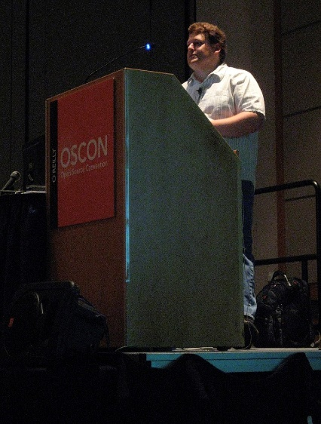
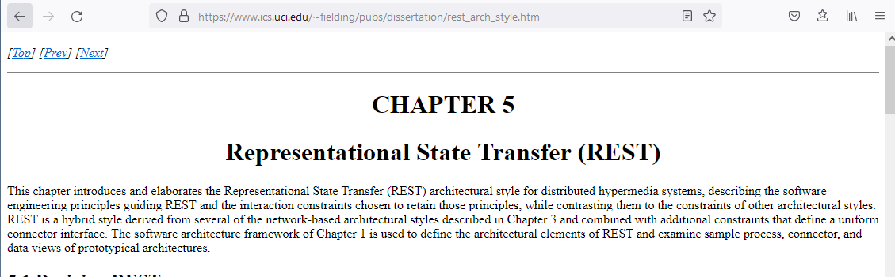
What is REST
One of the rare cases, in which a PhD dissertation actually moved IT industry a lot!

Slide 3
What is REST
As a software architect, I see it as an
Architectural style / pattern
It is another programming model
Functional programming:
Computation is passing data through chains of functions
Object programming:
Computation is community of objects passing messages
RPC over Client-Server:
Computation is clients invoking procedures on remote servers
REST
Computation is clients manipulating resources using CRUD ops and moving through states using hypermedia links

Slide 4
Programming Model
Broker pattern
Supports RPC/RMI between clients and servers
State changes through accessors and mutator methods
Any interface is possible
REST
Supports only CRUD on remote resources (=Data objects)
Supports workflow through hypermedia links
Very different programming model required compared to Remote Method Invocation/Broker
Not all systems are suited for REST !

Slide 5
Roy Fielding’s work
Goal: Keep the scalable hypermedia properties of WWW
REST = REpresentational State Transfer
Transferring a representation of data in a format matching one of standard data types (media types)
Resource: any information that can be named
Identified by a resource identifier
URI = Uniform Resource Identifier
Interactions are stateless
Each request contains all the information necessary
Exercise: Why is everybody so keen on ‘stateless’? What QA is involved?

Slide 6
Representing Resources

Slide 7
Example
Resource: Inger’s blood pressure measured on 29/6/2017
Representation of data using standard media type:
{ pid: ”251248-1234”, sys: 120.0, dia:70.0 } (json)
Resource identifier
http://telemed.org/bp/251248-1234/made-29-06-2017-09-59-17
I.e. Inger’s resource (her blood pressure measurement) is uniquely identified using this URI

Slide 8
Example: CRUD
Inger makes the measurement CREATE
POST /bp
Body: { pid: ”251248-1234”, sys: 120.0, dia:70.0 }
Response
StatusCode: 201 CREATED
Location: /bp/251248-1234/made-29-06-2017-09-59-17
Body: { pid: ”251248-1234”, sys: 120.0, dia:70.0, status: ”new” }
Meaning
The resources was created, has resource id
/bp/251248-1234/made-29-06-2017-09-59-17

Slide 9
Example: CRUD
Inger reviews the measurement READ
GET /bp/251248-1234/made-29-06-2017-09-59-17
Body: (none)
Response
StatusCode: 200 OK
Body: { pid: ”251248-1234”, sys: 120.0, dia:70.0, status=”new” }
Meaning
The resources was found, and the measurement returned

Slide 10
Example: CRUD
Inger updates the measurement UPDATE
PUT /bp/251248-1234/made-29-06-2017-09-59-17
Body: { pid: ”251248-1234”, sys: 126.0, dia:69.0 }
Response
StatusCode: 201 CREATED
Body: { pid: ”251248-1234”, sys: 126.0, dia:69.0, status=”revised” }
Meaning
The resources was found, and the measurement updated

Slide 11
Example: CRUD
Inger deletes the measurement DELETE
DELETE /bp/251248-1234/made-29-06-2017-09-59-17
Body: (none)
Response
StatusCode: 204 No Content
Body: none
Meaning
The resources was found, and the measurement deleted

Slide 12
Prototype: pastebin
REST is pretty lightweight programming wise…
Goal: AP to demonstrate ”pastebin”
Online service for storing text messages = ‘post-its’
Total time: 1.5 hour (well – a bit cheating)
Developed
Webserver, accepting POST and GET
Using Spark-java framework (IPC) and GSON (Marshaling)
Client: curl or httpie ☺
Notes:
1.5 hours was a bit cheating, I already had some boilerplate code hanging around…

Slide 13
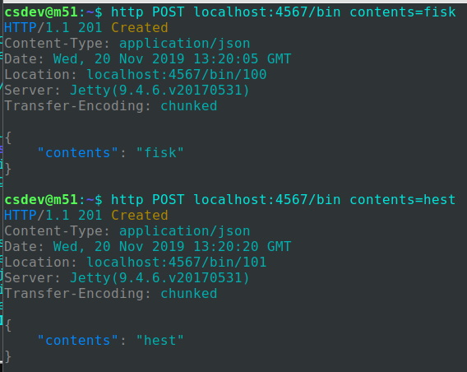
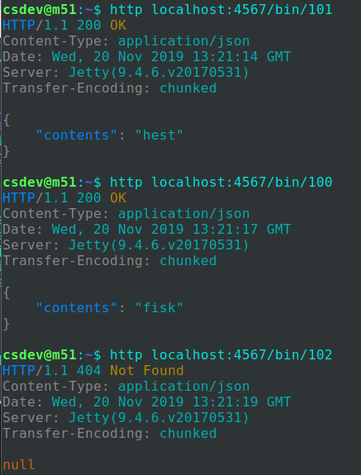
Demo
CREATE fisk and hest
READ 100, 101, 102

Slide 14
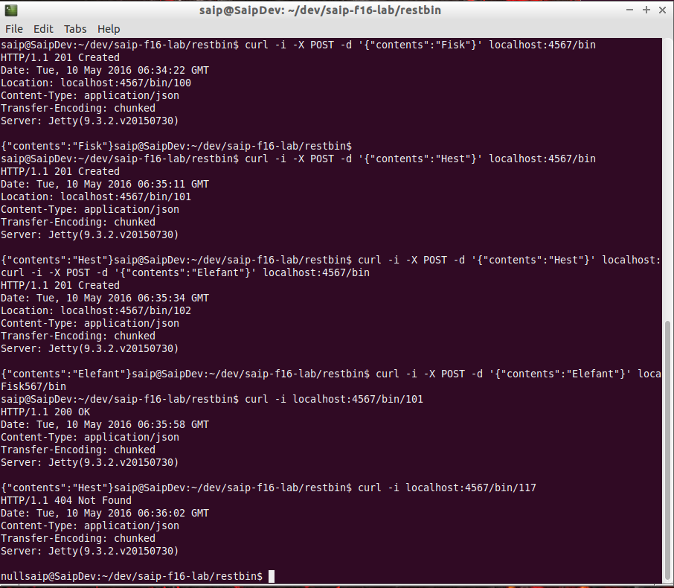
Or Curl…
POST ‘Fisk’, ‘Hest’ and ‘Elefant’ in bins
Assigned bin 100, 101, 102
GET bin 101
Which is ‘Hest’
GET bin 117
Which is not found (404)

Slide 15
Note
POST of course needs to tell client the resource identifier of the newly created object!
Response contains a ‘Location’ field
Standard way for POST communicate ‘resource id’

Slide 16
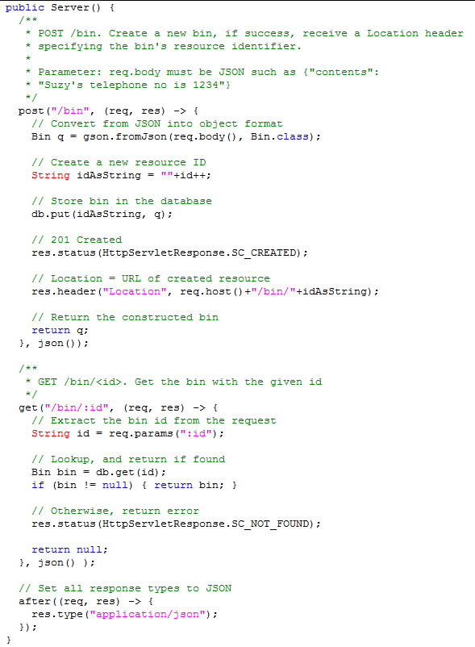
Server code
A PasteBin server in 50 lines of Java
OK, Spark-java helps quite a bit!
Is in the ‘FRDS.Broker’ codebase, as an isolated project. (You have to change to the pastebin folder to make it work)

Slide 17
Left as an Exercise
We should be able to update a text in pastebin
PUT verb
And delete an entry
DELETE verb

Slide 18
Discussion
REST uses the HTTP as designed
CRUD verbs and Status Codes (methods, return type)
Virtually allows all Information Systems operations !
URLs as resource identifiers (location+object)
Always identify the same resource, and representation of state is always communicated
Well defined data representations (media types)
JSON has become favorite (readable + small footprint)

Slide 19
Richardson’s Maturity model
From low maturity to high maturity
URI Tunnel
Just use HTTP as IPC layer
SOAP, WSDL, WebServices
And our URI Tunnel Broker!
HTTP
Use CRUD Verbs on resources
Hypermedia
Use links to define workflows
Hypermedia
HTTP
URI Tunnel

Slide 20
Level 2 REST

Slide 21
Workflow
Business systems can often be modelled as workflows
CS term: State machines / state graphs ☺
Ex: Book a flight
I search for flights available get list of links
I pick one particular flight get ‘book’ link
I book the flight enter personal details
I pay for the flight enter credit card details
I get a) e-ticket b) receipt get two links

Slide 22
Exercise
I search for flights
What HTTP verb is that? What resources are involved?
I book the flight
What HTTP verb is that? What resources are involved?
I pay for the flight
What HTTP verb is that? What resources are involved?
I get my e-ticket
What HTTP verb is that? What resources are involved?
Notes:
GET /flight return [ {flight:’sk992’, …}, {…]
POST /booking/sk992
body {name: ”henrik”, …}
response: Location /booking/sk992/hbc-sk992
POST /booking/payment/hbc-sk992
body { cardid: ”1234-1234-1234-1234”, …}
response: Location /booking/payment/hbc-sk992
body { etciket: /eticket/hbc-sk992, receipt: /receipt/hbc-sk992

Slide 23
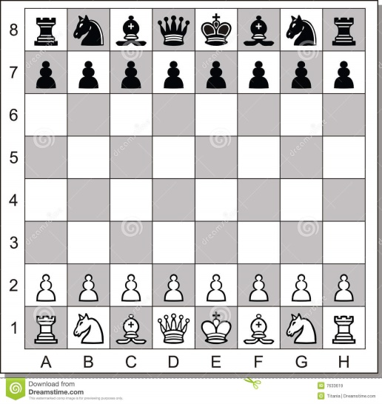
Level 2: Hypermedia
Workflows are not just ‘CRUD a resource’, rather more complex
Transactions: Multiple entities atomically updated
State transitions: Mutator methods that updates several entities and/or updates state
Ex: A game’s move(f,t) method
Validate move (may return ‘not valid’)
Update board state (transaction, e.g. king castling)

Slide 24
Analysis
‘move()’ using HTTP verbs ???
Is it possible at all?
Analysis A:
”No, we cannot do that”
Because ‘move’ is not a create, it is not a read, nor update, nor delete of a single resource (stateless)

Slide 25
Analysis
‘move()’ using HTTP verbs
Analysis B: Maybe it is an update of game
PUT /game/47
Body: Full board state with the move executed
But – then the server has to infer the move from the delta between state ‘before’ and state ‘after’ which is weird!
And it is definitely not stateless – right?

Slide 26
Analysis
Analysis C: A ‘state transition resource’
Creating a game, is creation of two resources
The game resource /game/47/
The move resource /game/47/move or /game/move/47
PUT /game/47/move
Body: { from: e2, to: e4, player:white}
This will
Try to UPDATE the state => 200 OK or 401 Invalid
If 200 OK, then the game resource is also updated
And can be successively GET to see new board state

Slide 27

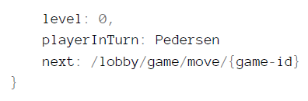
Challenge
But how do we return two resources from the game create POST message?
We can not, but we can use the WWW way – provide hypermedia links!!!
boardState: [ ... ],

Slide 28
Aka
HATEOAS:
Hypermedia As The Engine Of Application State.
Application state changes are modelled as hypermedia links, each to a resource that objectify the change itself, not the old/new state of underlying objects
A ‘move’ resource, a ‘payment’ resource, a ‘send items to address’ resource, etc.

Slide 29
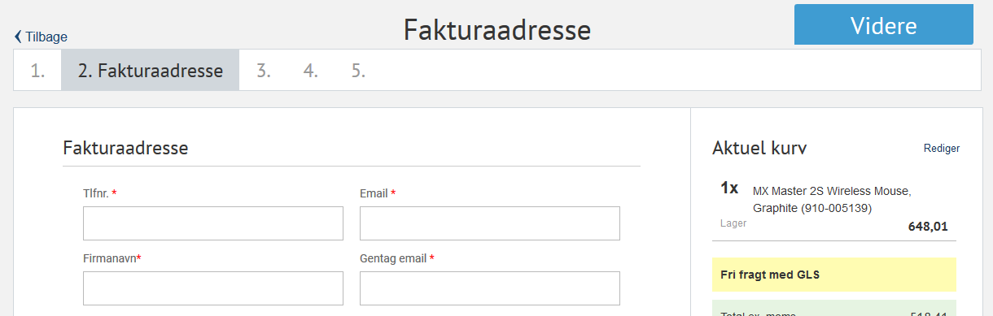
Often visible in UI
The state changes of the order

Slide 30
Level 2: Hypermedia
So – REST is a radically different architectural pattern/style, different from OO and interface-based paradigms
POST to create a resource
May return several hypermedia links that define valid state transitions for the resource
Which are then manipulated through the HTTP verbs
Makes potential state transitions discoverable
Just like any new web page presents links that I may follow
Hypermedia
HTTP
URI Tunnel

Slide 31
Example 1
Strong inspiration from:
”How to GET a cup of Coffee”
By Webber et al.

Slide 32
Context
Webber et al.’s paper outline the full Hypermedia approach for building REST based systems
We will take an alternative/simpler route
We will keep using JSON, instead of XML
We will encode the statemachine in the code base instead of coding it like links in the XML (‘next’ in webber’s paper)
They need to code logic to interpret ‘next’ tag anyway so our binding is not that much harder than what Webber presents.

Slide 33
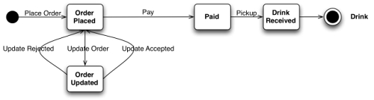
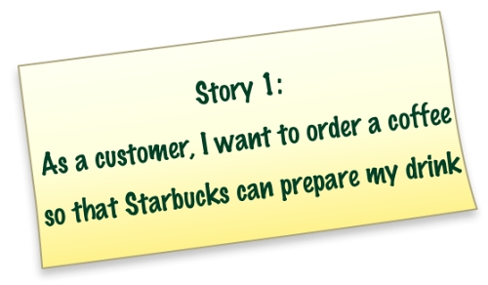
Coffee Shop
A web shop for ordering coffee – and paying…

Slide 34
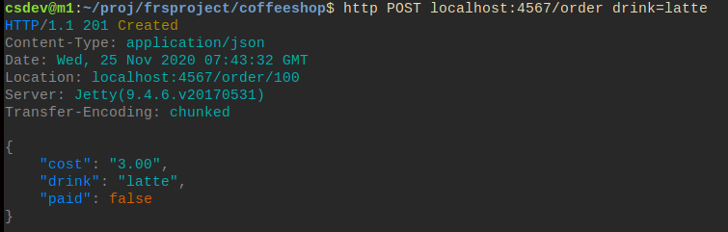
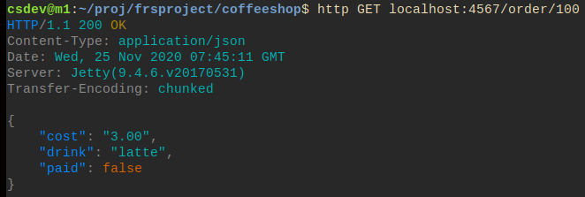
Example: Story 1 (Coffee order)
POST on /order
GET on /order/{id}
Notes:
Coffeeshop code in frsproject repo.
http POST localhost:4567/order drink=americano

Slide 35
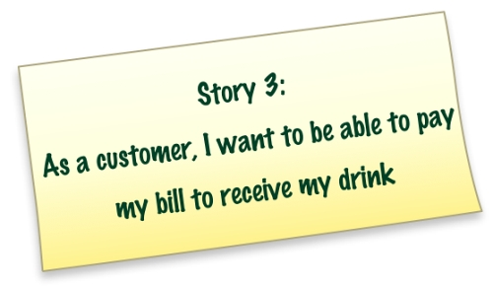
Coffee Shop

Slide 36
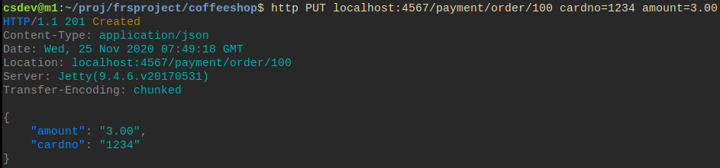
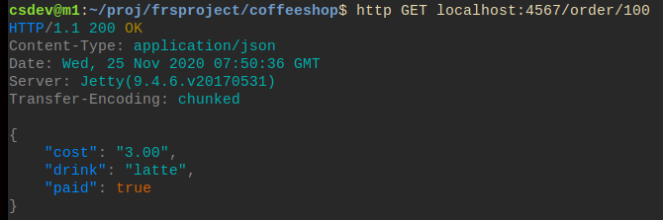
Example: Story 3 (Coffee Payment)
Another object /payment/order/{id} is also created
Payment becomes updating this object!
And a new get shows the state change of the order
PUT on /payment/order/{id}

Slide 37
Example: Story 3 (Coffee Payment)
In Webber et al.’s paper, the XML will provide the payment resource id as ‘next’ tags
The hypermedia approach:
Provide the client with multiple options to move to new info/actions through providing links
I just ‘agreed’ on the resource path in the code base…
PUT on /payment/order

Slide 38
Example 2

Slide 39
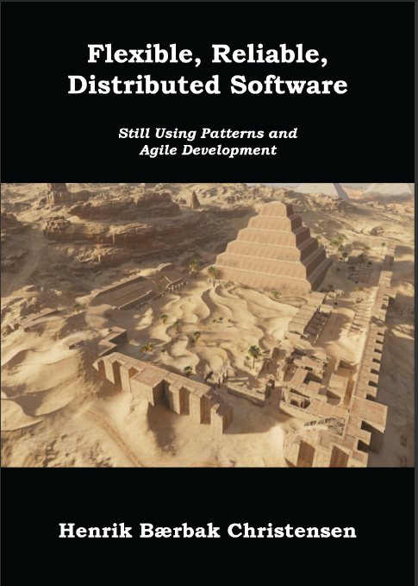
GameLobby
Joining a Game result in a game ressource to be CRUD’ed
Read the book ☺

Slide 40
REST versus Broker
Pros And Cons

Slide 41
Rest or Broker
REST is the better choice because
In 2020 it is much more widely used than Broker architectures
REST promises scalability, performance, reliability
Lighter and direct programming model (contrast SOAP/WSDL)
Direct interaction (manual test) via ‘http’ or ‘curl’
REST is the lesser choice because
Programming model is at low abstraction level
All responsibilities are mixed together = Blob antipattern
HATEAOS even mixes UI responsibilities into domain ☹ ☹ ☹
‘links’ are part of the domain object
Not just a coffee order but coffee order + URL links to state changes

Slide 42
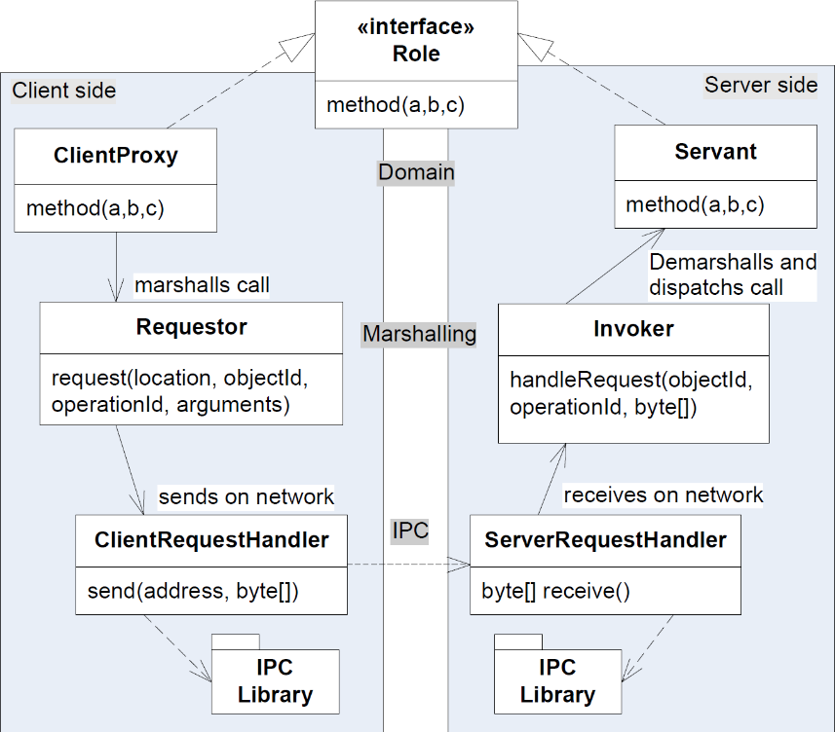
Mixed Responsibilities
Broker separate distinct responsibilities
Domain layer, marshalling layer, IPC layer
REST actually addresses responsibilities on both the Marshalling, Location, and IPC level in one big ball of mud
Low cohesion ☹

Slide 43
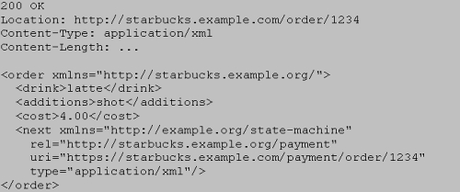
Mixing UI State and Domain
From Webber’s CoffeeShop
Domain object
An Order
UI/State object
Links that are URL encoded mixed into the ‘ball of mud’
Demarshalling becomes tedious

Slide 44
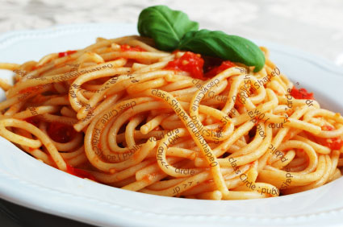
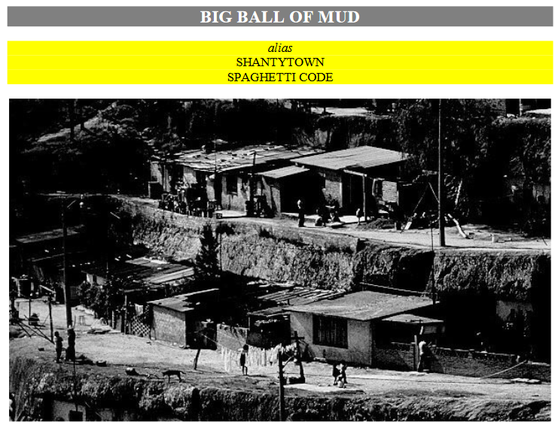
Both pull the same way ☹
Spaghetti code // Big ball of mud
Look for Brian Foote and Joseph Yoder’s paper

Slide 45
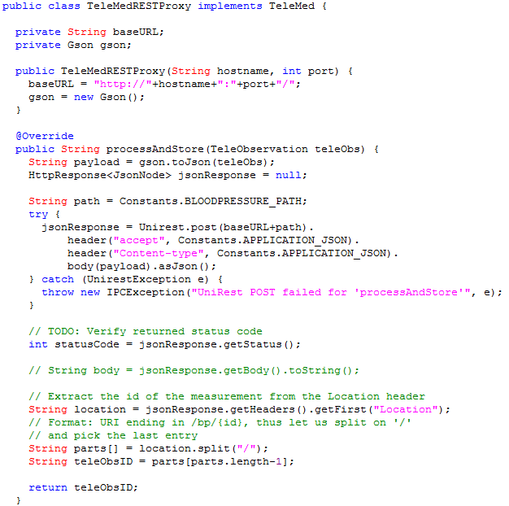
Ex: TeleMedRESTProxy
Using a good REST library (here: uni-rest), the code is small …
This Proxy plays all roles
Proxy
Requestor (GSON)
ClientReqH. (UniRest)
Location field read to retrieve ID of resource

Slide 46
Restating my Claim
Broker Pattern is as strong as REST iff
You simply obey the same fundamental architectural constraints as REST impose
Only pass-by-value
Use the ‘pass objectId’ technique for server -> client ‘pass by reference’
Pure client-server - no server calling methods on clients
Design your Remote Roles with distribution in mind
Not ‘game.getUnitAt(p)’ Chatty interface
But ‘game.getFullGameState()’ Chunky interface

Slide 47
Summary
UR Tunnelling
Just uses HTTP and web technology/frameworks as the IPC layer in the Broker
That is : transport network packages to/from client and server
REST
Architectural Pattern what deeply exploits HTTPs advantages
Lightweight with less tool support
Focus is on performance and scalability because
True Client-server No callback/observer pattern
Value passing of information

Slide 48
Summary
Broker pattern and REST?
Only if the OO interfaces/roles are designed so they adhere to the REST way of architecture
CRUD on ‘objects’ = resources
State transitions modelled as ‘transition resources’
Bit similar to Command pattern objects…
… and generally you do not design OO that way…
REST and OO are two different architectural styles…

